Slide 1

Diabetes: An Investigation into Contributing Factors
Collaboration by:
Meagan Coldewe
Harsh Kapadia
Rodney Weekes
Image Credit: Buravleva stock/Shutterstock.com

Slide 2
Diabetes Prediction Dataset
Features:
Age
Gender
Body Mass Index (BMI)
Heart Disease
Smoking History
HbA1c Level
Blood Glucose Level
Hypertension
Diabetes Status
Site Link: https://www.kaggle.com/datasets/iammustafatz/diabetes-prediction-dataset?resource=download
Notes:
MC - where and how we found the data; what motivated us to answer our questions

Slide 3

Data Cleaning
Limited cleaning necessary
Renamed columns for readability
Replaced variable names for uniformity
Image Source: https://www.freepik.com/free-photos-vectors/data-cleaning?log-in=google
Notes:
RW:
Check for non-null values, then made sure each column has usable/appropriate values
Smoking Column had repeated values, corrected the repeats
Split Age column into quartiles, allows to incorporate age in our testing

Slide 4
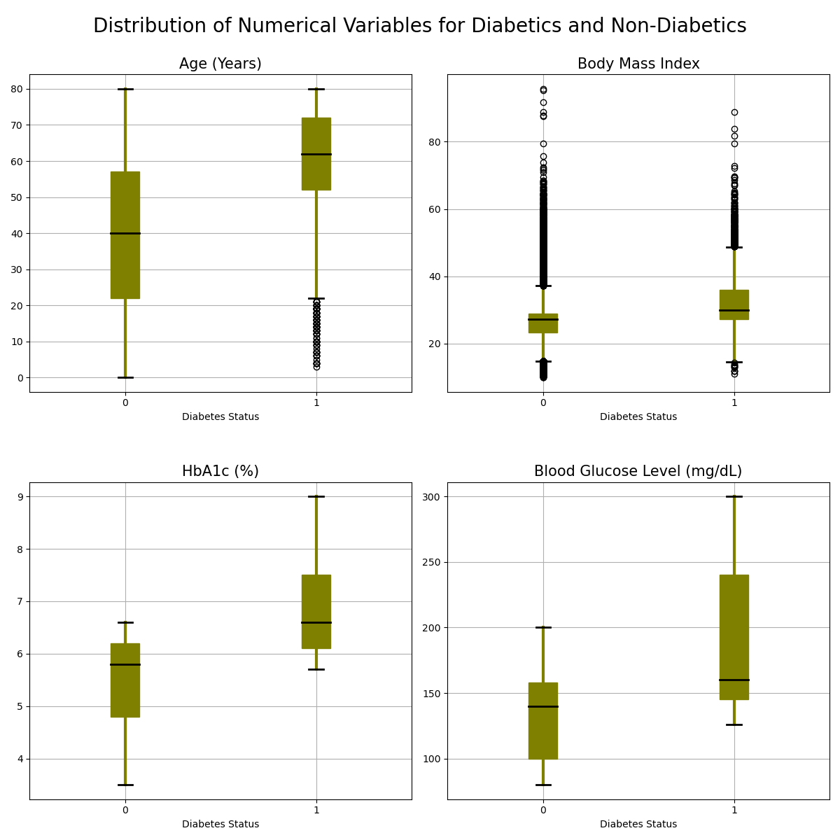
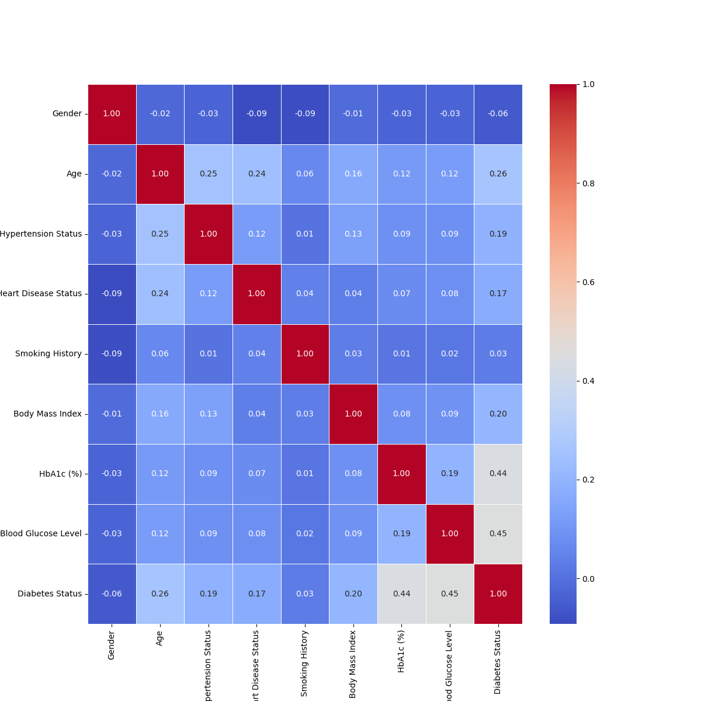
Raw Data Visualization
Notes:
HK:
1) Two types of variables in dataset: categorical and numerical
The distributions were all skewed and non parametric
2) Visualized the numerical raw data with boxplots
3) Visualized the categorical raw data with bar charts
4) Dataset is designed for machine learning, we have no idea how that works, but we utilized the correlation matrix that often is used for machine learning
Seaborn library for heatmap (helps with visualization)

Slide 5
Question 1:
Null Hypothesis:
The likelihood of having either hypertension, heart disease, or both conditions is the same for both diabetic and non-diabetic populations.
Alt Hypothesis:
The likelihood of having either hypertension, heart disease, or both conditions is significantly higher for diabetics compared to non-diabetics.
Is the likelihood of having either hypertension, heart disease, or both conditions significantly higher for diabetics compared to non-diabetics?
Notes:
MC:

Slide 6
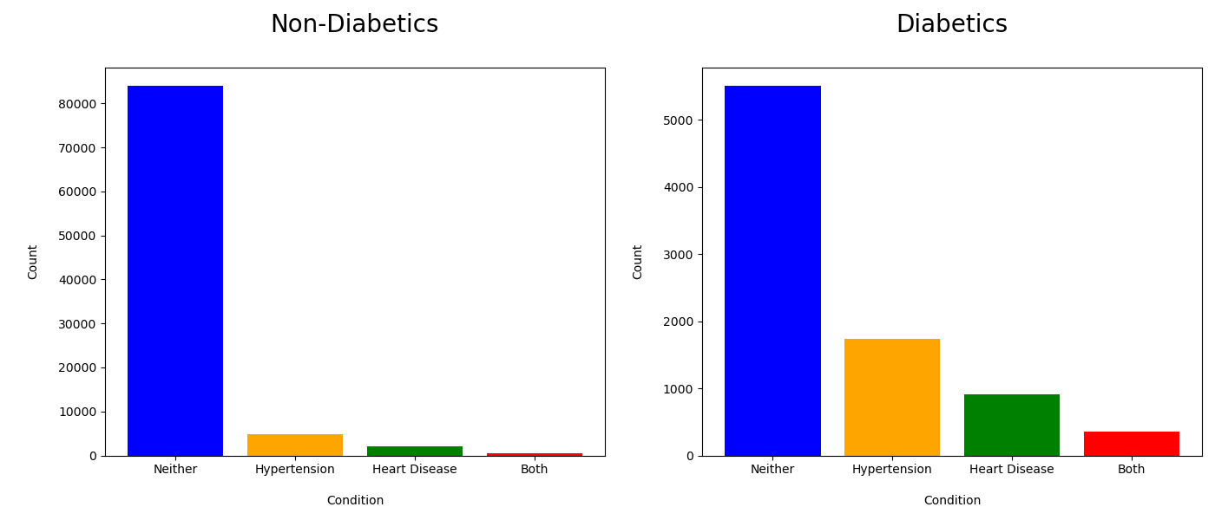
Question 1: Diabetes, Hypertension, Heart Disease
Notes:
Grouped by Diabetes Status, found counts of these three conditions
Plotted these counts as bar graphs (above)
Considered pie chart, but too difficult to read

Slide 7
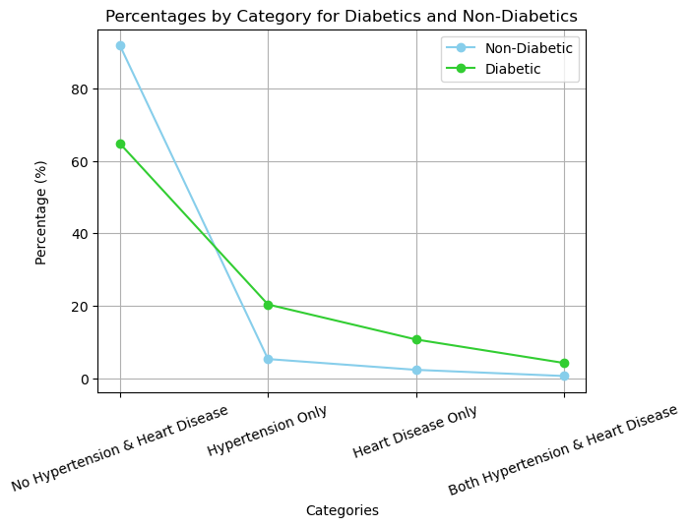
Question 1: Z-scores
For Neither Condition: Z-score: -77.77304102647878 P-value: 0.0 For Hypertension Only: Z-score: 53.62622146321058 P-value: 0.0 For Heart Disease Only: Z-score: 43.14451252667288 P-value: 0.0 For Both Conditions: Z-score: 33.34307215690896 P-value: 4.589844965633299e-244.
Notes:
We had categorical data, so we used the z-test of proportions
Large sample sizes and there’s only two outcomes (have it or you don’t)
Ran four z-tests for each category, diabetic vs. non-diabetic
Results:
all four tests had p-values & z-statistics that showed our differences were significant
Our tests allowed to investigate the directionality as well (which direction was more frequent diabetics or non-diabetics)
Actual test results: large z-values and very small p-values
Looking at the line graph: for each condition the diabetics have a higher percent of affliction compared to non-diabetics
Accepting the alternative hypothesis
Implications: htn/hd is more common for diabetics so clinicians should incorporate these cardiovascular assessments in their treatments plans

Slide 8
Conclusion:
The investigation found that diabetics have a notably higher chance of developing hypertension, heart disease or both compared to non-diabetics.

Slide 9
Question 2:
Null Hypothesis:
There is no significant difference in average BMI between individuals with or without diabetes.
Alt Hypothesis:
Average BMI is significantly higher for individuals with diabetes compared to those without.
Is average Body Mass Index (BMI) significantly higher for individuals with diabetes?
Notes:
RW:

Slide 10
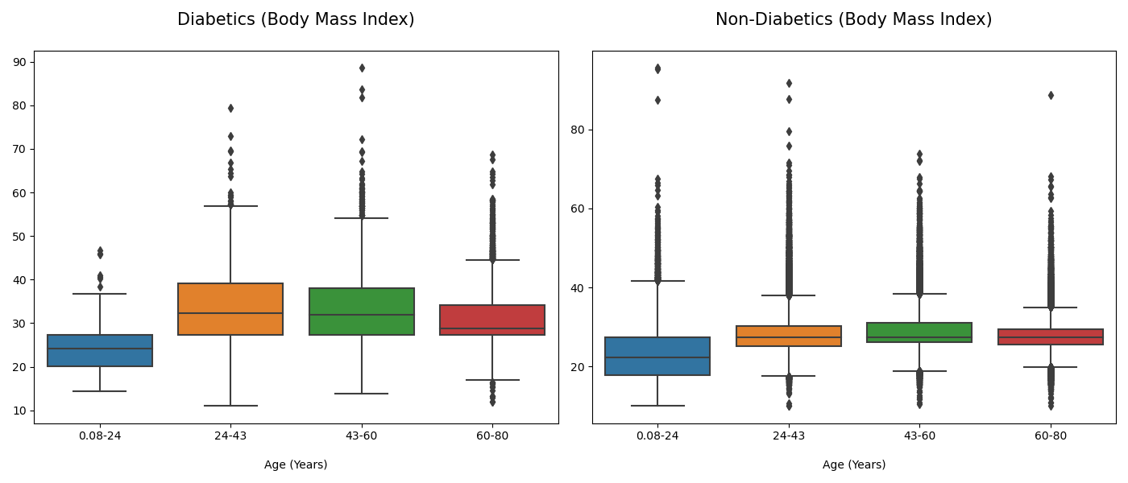
Question 2: Body Mass Index, Diabetes
Notes:
Raw data, no manipulation, what does the distribution look like for each age category (quartile)
Outliers across the board, distributions not normal, skew present in all of the left and green box on the right
Diabetic data is higher across the board than non-diabetc data

Slide 11
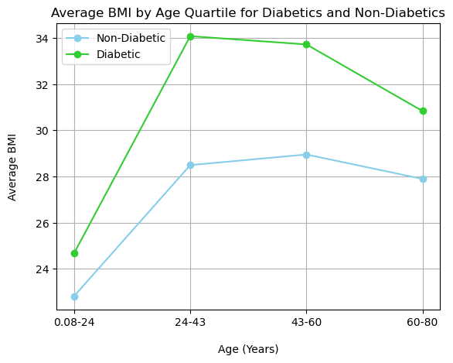
Question 2:
Statistical Test:
Mann-Whitney U Test
Results:
0.08-24 (Years):
U Statistic: 2321057.0
P-value: 1.98e-4
24-43 (Years):
U Statistic: 14766189.5
P-value: 1.48e-93
43-60 (Years):
U Statistic: 43079112.0
P-value: 9.04e-240
60-80 (Years):
U Statistic: 57203417.0
P-value: 2.55e-202
Notes:
We chose our statistical test as the Mann-Whitney U Test
Non-parametric test, less sensitive to outliers than other testing options, does not assume a normal distribution of the data
Results:
Ran 4 tests comparing average bmi for each age quartile between diabetics and non-diabetics
Mann-Whitney U Test allows to test for directionality, in this case that the direction for “higher” is towards diabetics
Tests outputs a u-statistic and p-value
All four tests had sufficiently high u-statistics and low p-values
Accept alternative hypothesis, the status of diabetes is associated with significantly higher BMI averages
Age suggests did not influence results
Implication: as a clinician managing diabetic patients, it is important to have weight management/monitoring as part of treatment plans

Slide 12
Conclusion:
The investigation found that individuals with diabetes have notably higher average BMI levels compared to those without diabetes.

Slide 13
Question 3:
Null Hypothesis:
The likelihood of having a current or former smoking history is the same for both diabetics and non-diabetics.
Alt Hypothesis:
The likelihood of having either a current or former smoking history is significantly higher for diabetics compared to non-diabetics.
Is the likelihood of having a current or former smoking history significantly higher for diabetics compared to non-diabetics?

Slide 14
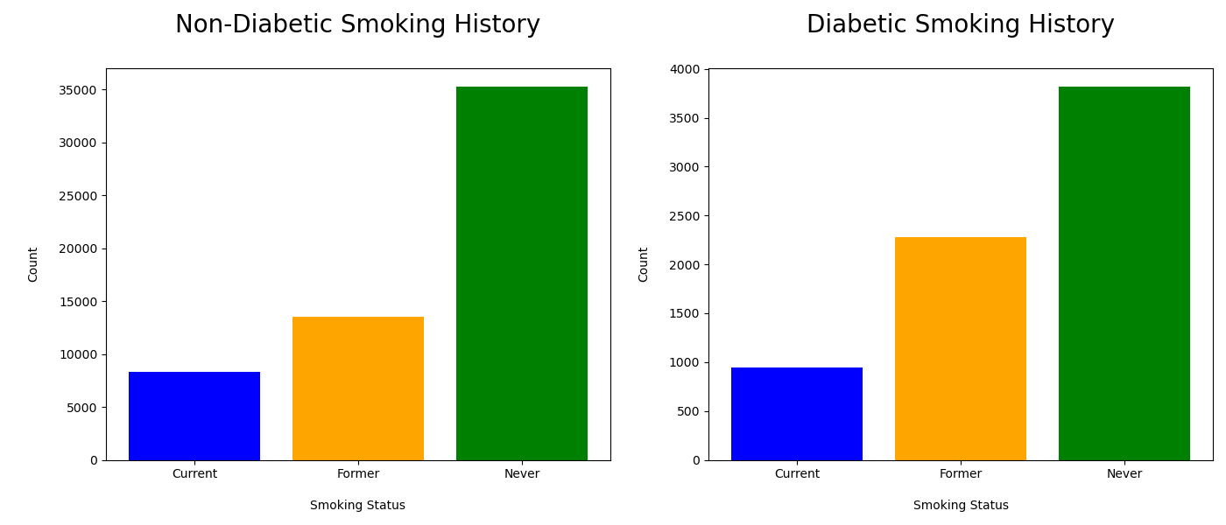
Question 3: Smoking History, Diabetes

Slide 15
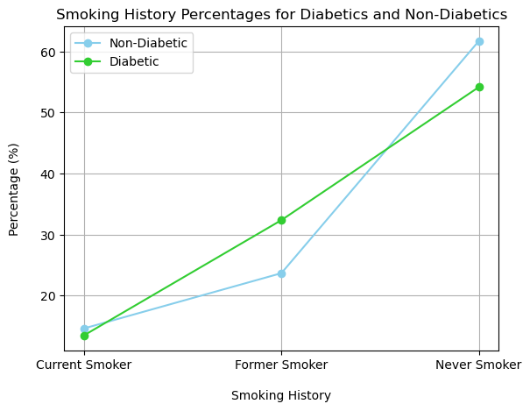
Question 3: Chi-Square
Test:
Chi-Square Tests
Conclusion:
Chi-Squared Value: 257.28
P-value: 1.36e-56

Slide 16
Conclusion:
The investigation found that individuals with diabetes are more likely to have a former smoking history compared to those without diabetes.
Notes:
The investigation found that individuals with diabetes are significantly more likely to have a former smoking history compared to those without diabetes.

Slide 17
Limitations
Meant for Machine Learning
The dataset is meant to run machine learning algorithms; without using machine learning, we were limited on the questions we could answer with the dataset.
Age, Hypertension, & Heart Disease
Age shows correlation with both conditions, which could mean that the closer relationship is with age rather than diabetes.

Slide 18
Thank You!

